Slide 1

EVALUATION OF THE MOJALOOP PLATFORM
Andrew Amstrong Musoke
Didier Ngabo
This project is developed under:

Slide 2
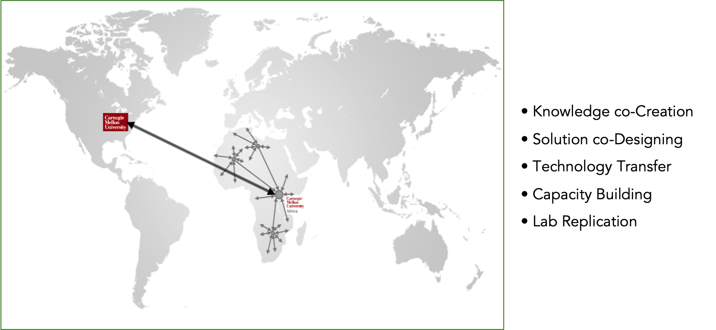
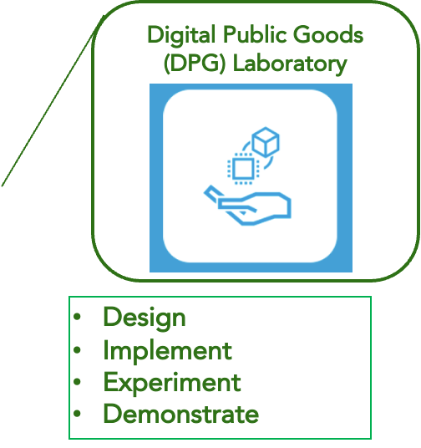
The Upanzi Digital Public Goods Network

Slide 3
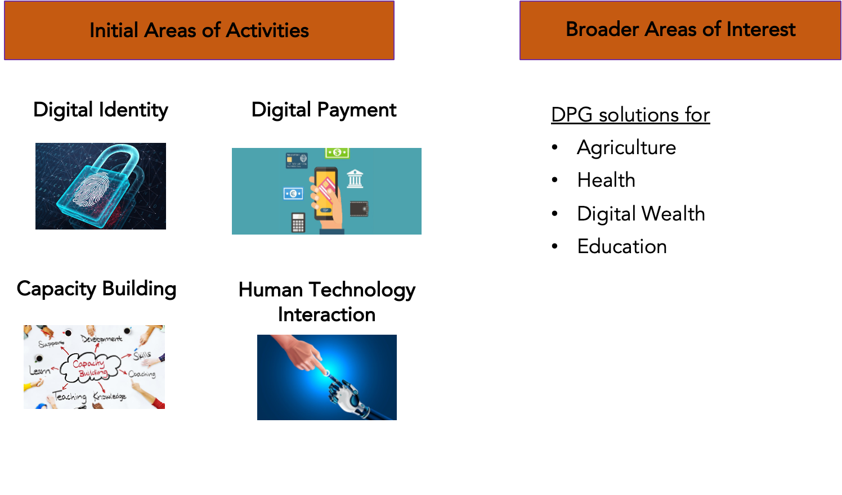
Digital Public Goods (DPG) Lab

Slide 4
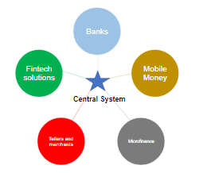
Motivation For The Evaluation
Rate of financial inclusion is hindered when financial providers operate in silos.
Mojaloop is an open source reference model for payment interoperability
How easy and secure-by-default is the deployment by a non-expert adopter?
Source: Digital identification: A key to inclusive growth (McKenzie, 2019)

Slide 5
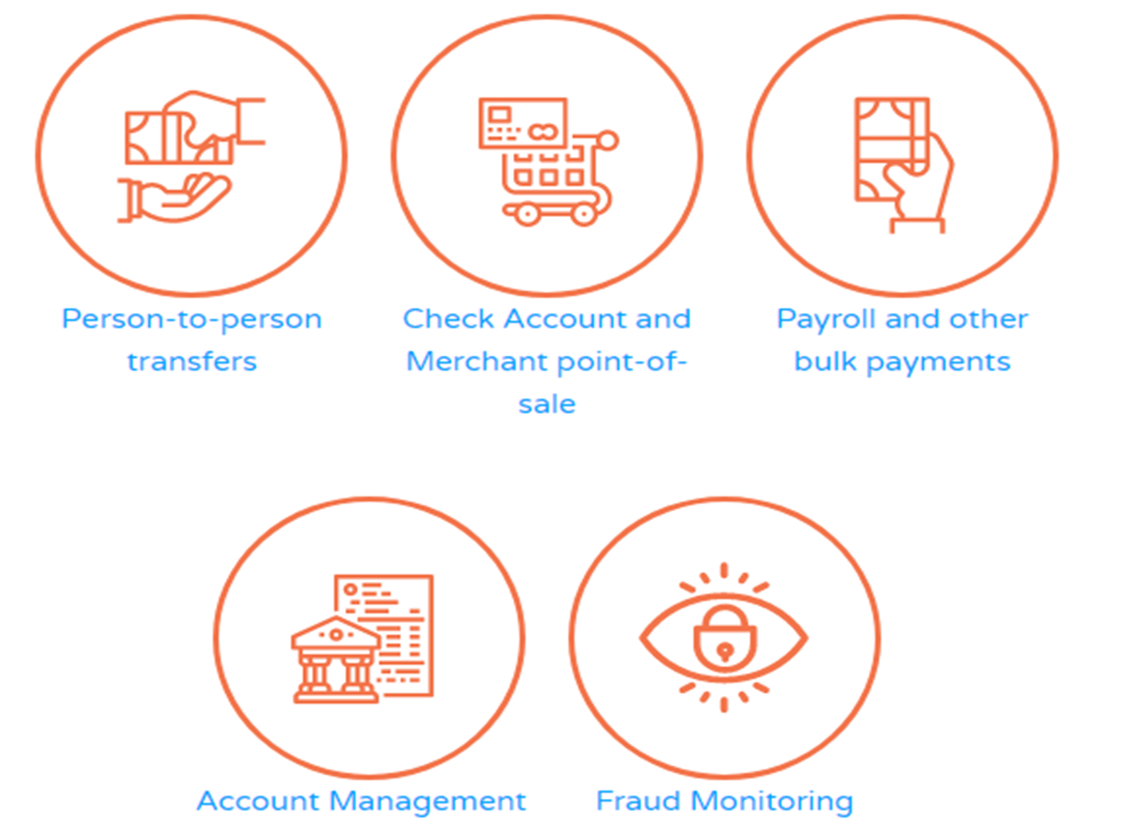
Deployability And Security
Multi-environment deployments and upgrades.
Documented experience and recommendations
Community engagements.
Security tests with VAPT team
Developing use-cases

Slide 6
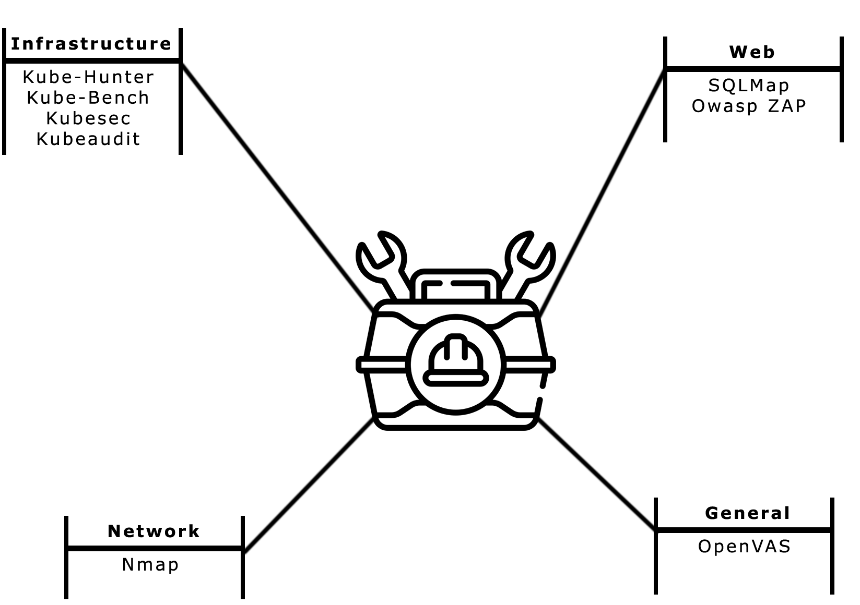
Developed Tools: Security Toolkit
Foundational toolkit for open source security tools.
Portable, customisable and modular.
Evaluates and reports baseline DPG security posture.
Image: https://flaticon.com

Slide 7
Experiences
All components tested are open source and open standards.
API documentation was not centralized.
Simulator invaluable for sanity checks and practical understanding of the flow.
Helm deployment needed tweaking out-of-the-box.
Separate networking from the helm chart. Allow flexibility in ingress type.
Need for infrastructure automation scripts for bootstrapping.
Logging and monitoring tools out-of-the-box were comprehensive.
Encourage community to share unique deployment experiences
Need security best practices and recommendations for deployment.
One week with helm charts version v13.0.2. Vs few hours with mini loop v4.1.

Slide 8
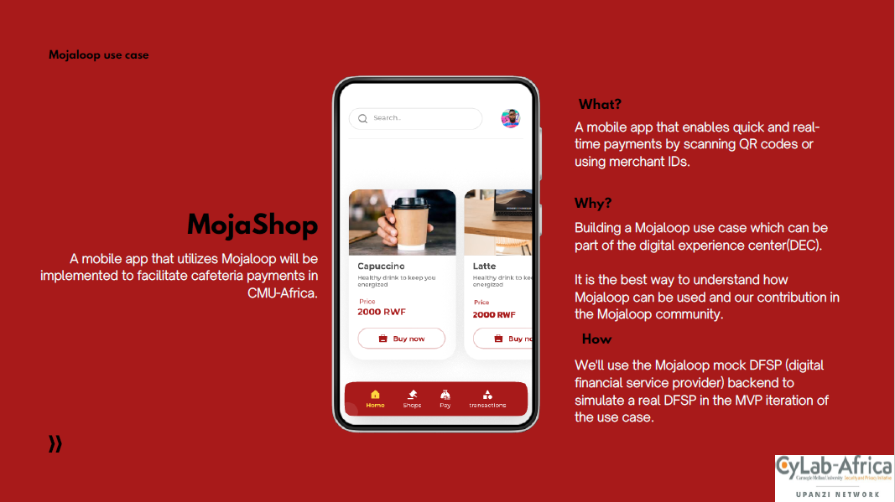

Slide 9
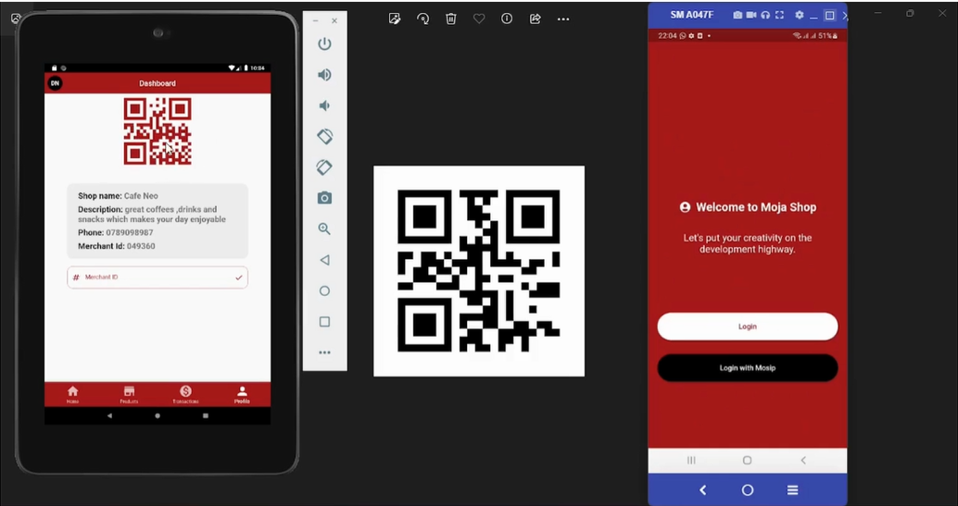

Slide 10
CYLAB DIGITAL EXPERIENCE CENTER
Andrew Amstrong Musoke
This project is developed under:

Slide 11

Background
What is the best DPG solution for you and your country’s situation?
Image: attorneyholcomb.com

Slide 12




What is the Digital Experience Center?
Facilitate digitalisation and decision making:
Hands on experiences
Access to sandbox environments
Access to impartial evaluations
Image: attorneyholcomb.com

Slide 13
LEARN | INNOVATE | CONTRIBUTE

Slide 14
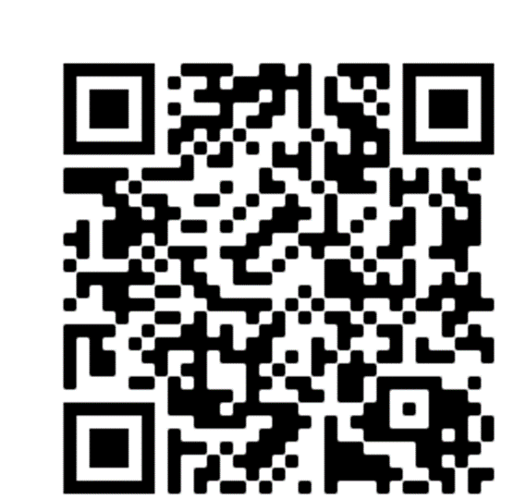
THANK YOU!
We would love to hear from you
Special acknowledgements:
Bill and Melinda Gates Foundation
amusoke@andrew.cmu.edu
dngabo@andrew.cmu.edu

